Slide 1
Attrition at Frito-Lays
Exploratory Data Analysis
Conducted by Johnny Vogt
DDS Analytics

Slide 2
Agenda
01
Executive Summary
04
KNN Model
Who are we?
Why was a case study conducted?
How does it help?
Model Based on similarity
02
Summary of Frito-Lays Employees
05
Naive-Bayes Model
Demographics
Avg. Income
Daily Commute
Attritioned vs. Non-Attritioned
Model based on probability
03
Correlations and Causations
06
Conclusion
Trends
Relationship between Variables
Reasons why people left
Fun Facts
Questions

Slide 3
01
Executive Summary

Slide 4
Executive Summary
WHO
DDS Analytics specializes in Talent Management Solutions and we primarily work with Fortune 100 Companies. We provide services that range from Workforce Planning, Employee Training, and reducing employee turnover.
WHAT
We were hired to assess company data and identify key factors that lead to attrition, to create models to help predict future attritions, and present our findings to the board.
WHY
Attrition Costs and Savings
Depending on the employee replacing them could cost 50% - 400% of that employee’s Salary (Employee Rentition)
Entry-Level: 30%-50%
Mid-Level: 125% - 150%
High-Level: 400%
Based on Frito-Lay’s Data that by providing roughly $200 worth of Attention and Incentives could save the company thousands of dollars in hidden overhead costs of replacing employees.
Discovering areas where the company can improve

Slide 5

$8,601,629
How much money it would take to replace every Employee that left Frito-Lays

Slide 6
02
Employee Summary

Slide 7
Employee Demographics
870 Total Employees
Gender
Female:354
Male:516
Median Age: 37
Average Tenure
Mean: 5 Years
Median: 6 Years
Departments
Human Resources: 35
Research & Development: 562
Sales:273

Slide 8

Employees who left Employees who stayed
Total: 140 People
Age: 32 Years
Commute: 9 Miles
Salary: $38,052
Job Level:1
Tenure:3 Years
Time in Current Role:2 Years
Gender
Male: 87 / 15 %
Female: 53 / 16.9%
Attrition by Department
HR: 6 / 17.1%
R&D: 75 /13.3%
Sales: 59 /21.6%
Total: 730 People
Age:36 Years
Commute:7 Miles
Salary:$62,502
Job Level:2
Tenure: 6 Years
Time in Current Role: 3 Years
Gender:
Male: 429 / 85 %
Female: 301 / 83.1 %
Retention by Department
HR: 35 / 82.9%
R&D: 562 / 86.7%
Sales: 273 / 78.4%

Slide 9
03
Correlations and Causations

Slide 10
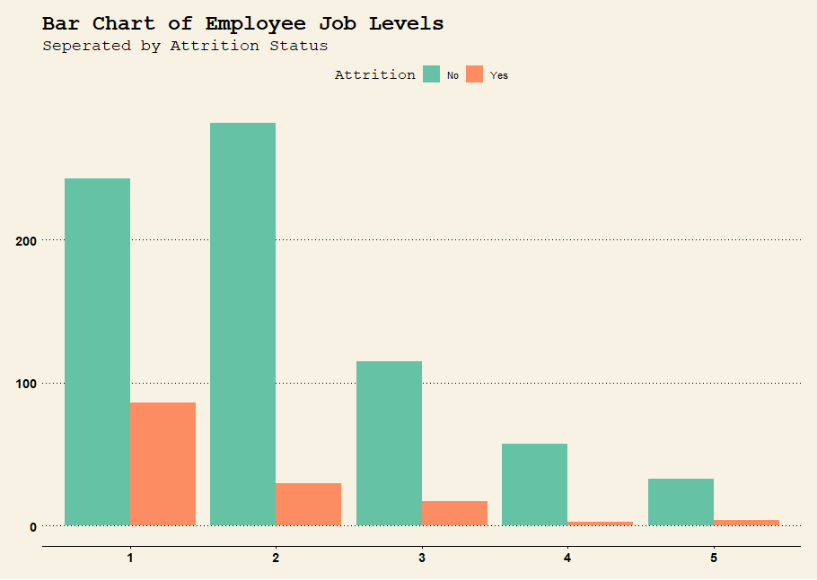
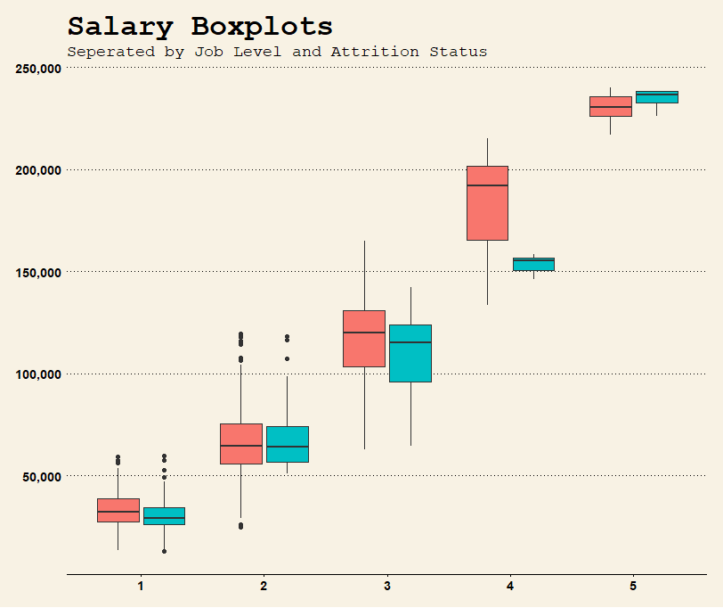
Visualization is KEY
As we start to visualize relationships between data points, we can start to see patterns. Some graphs may directly help, some may help indirectly

Slide 11
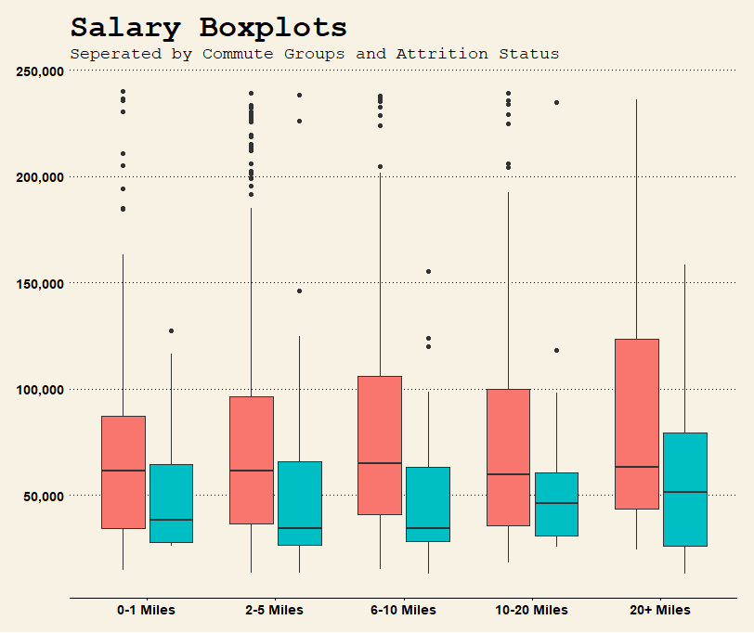
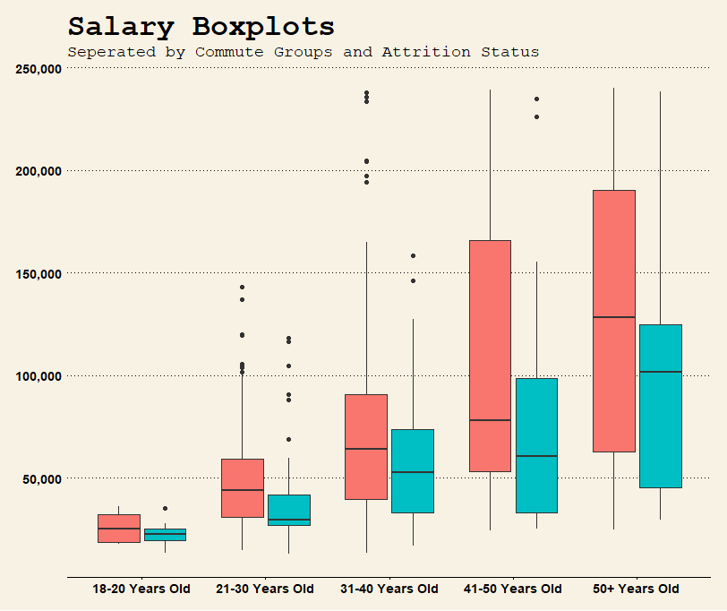
Comparing Salaries
Look at how regardless of what categories that we look on the X-Axis, the people the majority of people that left were making less money than their counterparts

Slide 12
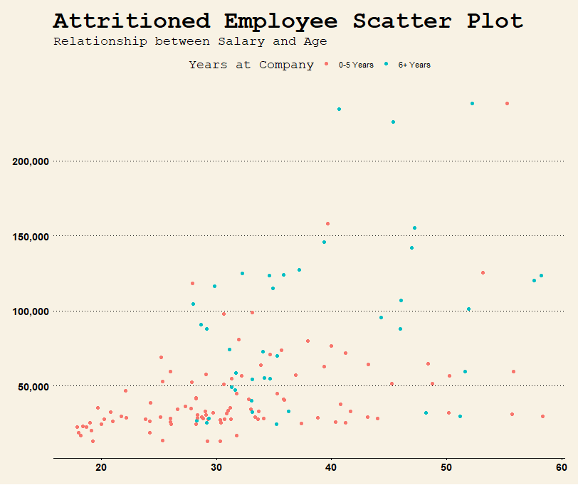
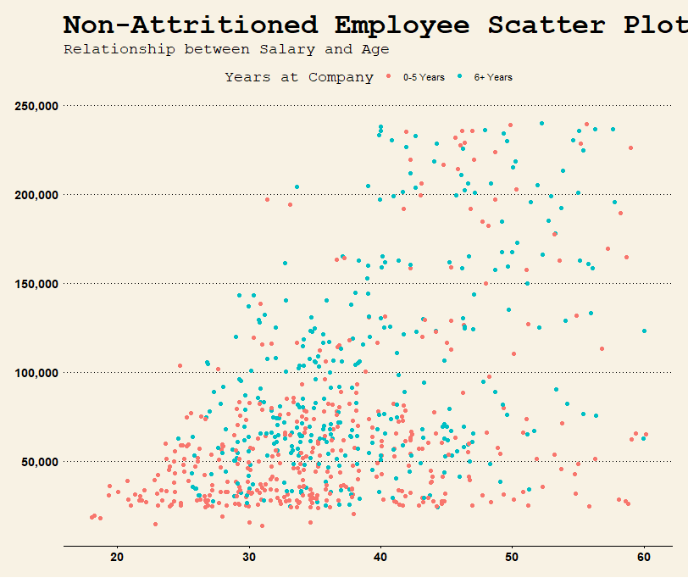
Scatter Plots
Notably, the important data to look at here is that most of the people that had left were BOTH early in their tenure and Under the age of 40

Slide 13
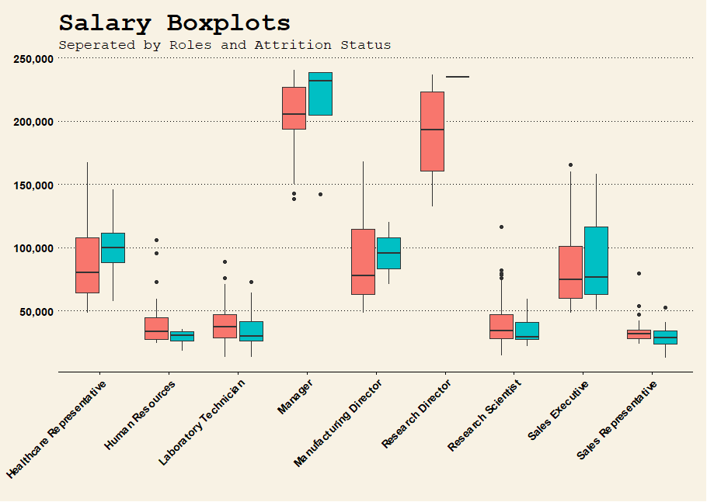
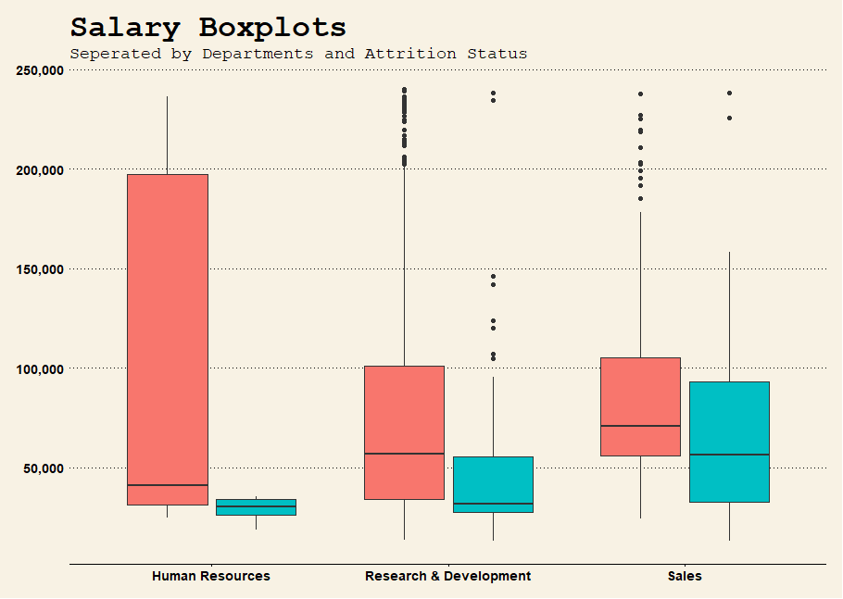
At the end of the day, its all about the Benjamins
When breaking down the data, it boils down to money. People making less money will leave in pursuit of more money. You can go down the list and keep finding similar relationships, but the fact will remain, the employees that were retained will make more on average than the employees that left.

Slide 14
04
KNN Model

Slide 15
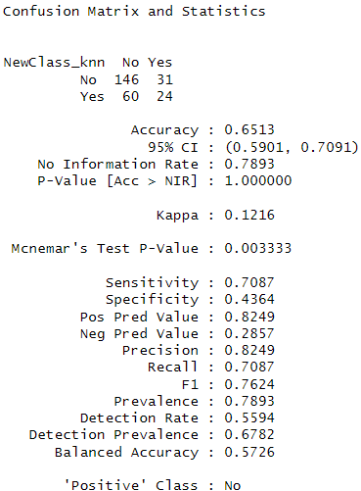
K Nearest-Neighbor Model
Model was Based on
Age
Salary
The K Value was set to 40
Has a fairly high Sensitivity rating

Slide 16
05
Naive-Bayes Model

Slide 17
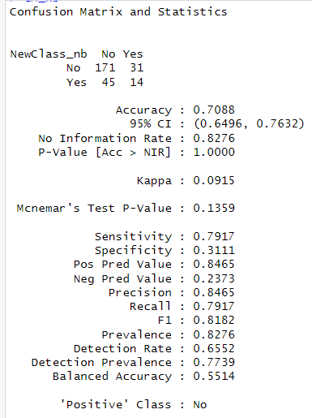
Naive-Bayes Model
Model Based on
Age
Tenure
Commute
Job Level
Role
Salary
Benefit:
High Sensitivity
May get more False Positives, but the benefits of intervening with a possible attrition far outweighs the opposite

Slide 18
06
Conclusion

Slide 19
Conclusion
People leave for money
When the employee feels as though they are not equal in compensation to their peers, the numbers suggest that they start to leave the company
Models are not extremely accurate, but can help employers detect potential employees looking to leave
Frito-Lays’ own data discovered that spending roughly $200 on each potential departure could sway an employee to stay.
It would cost $28,000 in incentives for each employee that had left.
The Median cost of attrition for employee that left is roughly $11,000
The Cost-to-Benefit Ratio is very high, it would take converting roughly 3-4 out of 140 Employees to make up that cost.

Slide 20

Questions??

